Slide 1
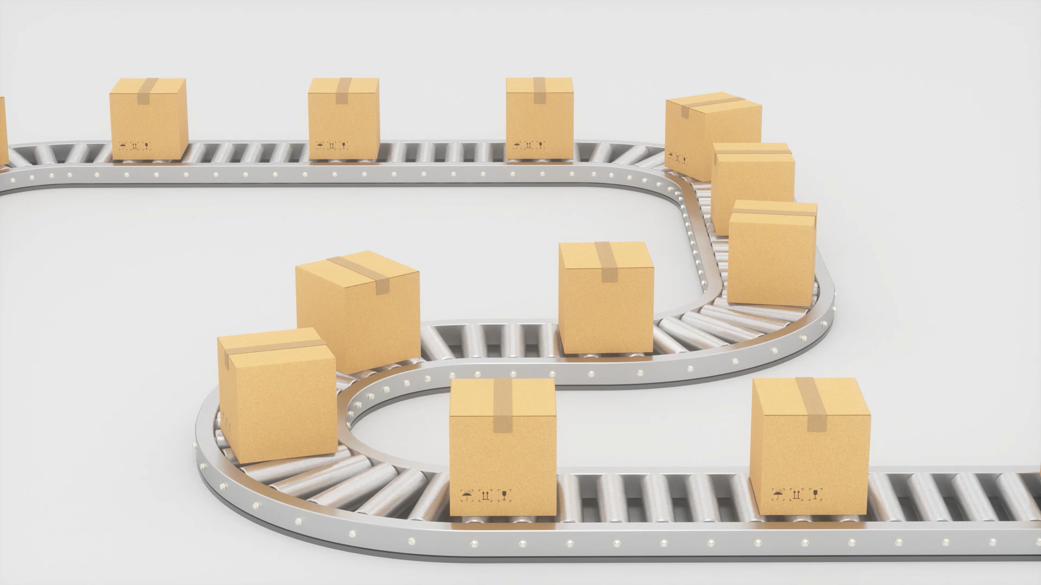
Logistics

Slide 2
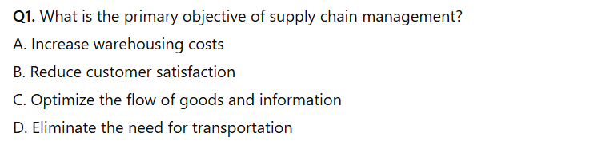
Quiz

Slide 3
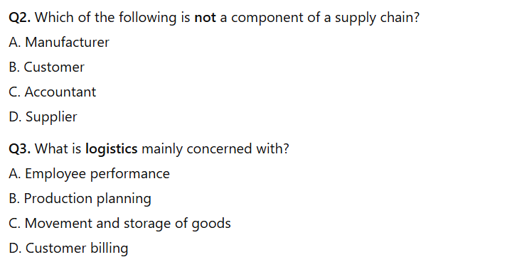

Slide 4
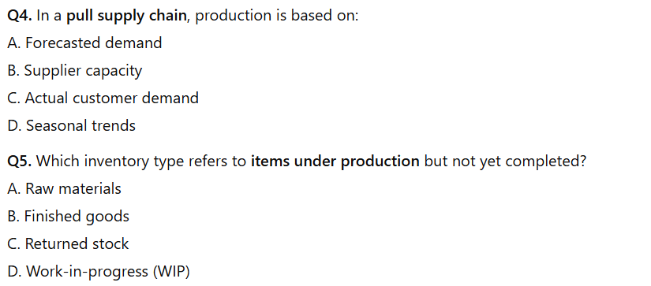

Slide 5
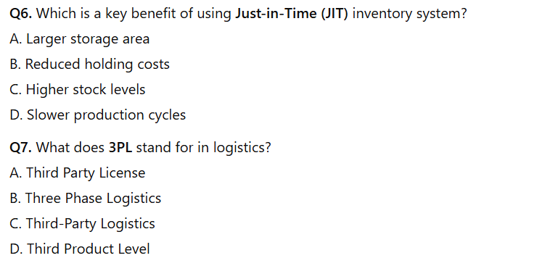

Slide 6
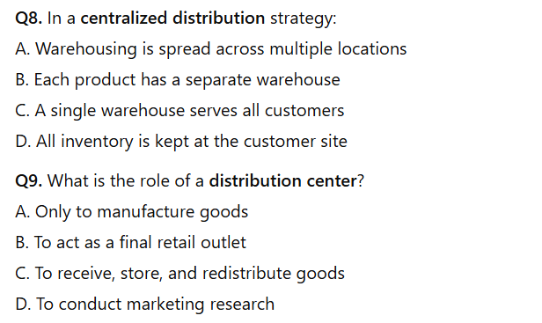

Slide 7
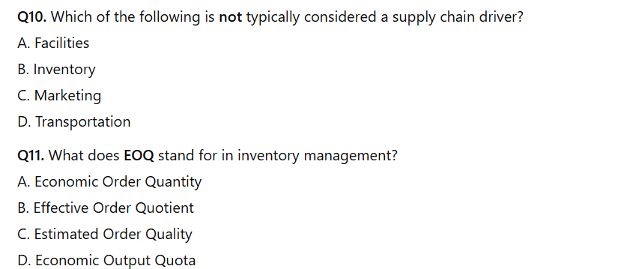

Slide 8
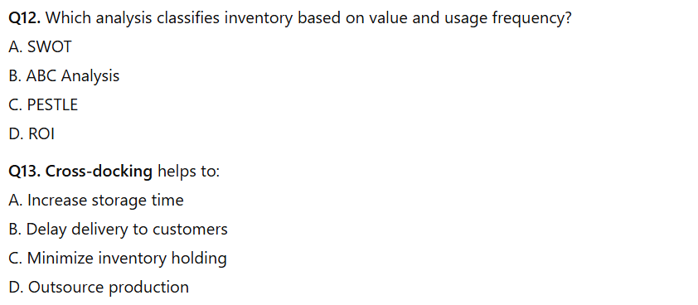

Slide 9
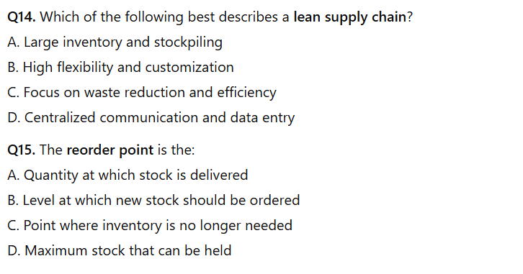

Slide 10
Answers

Slide 11
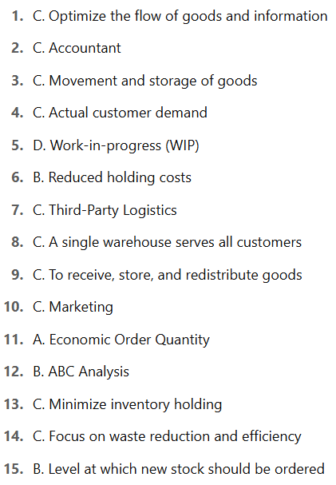

Slide 12
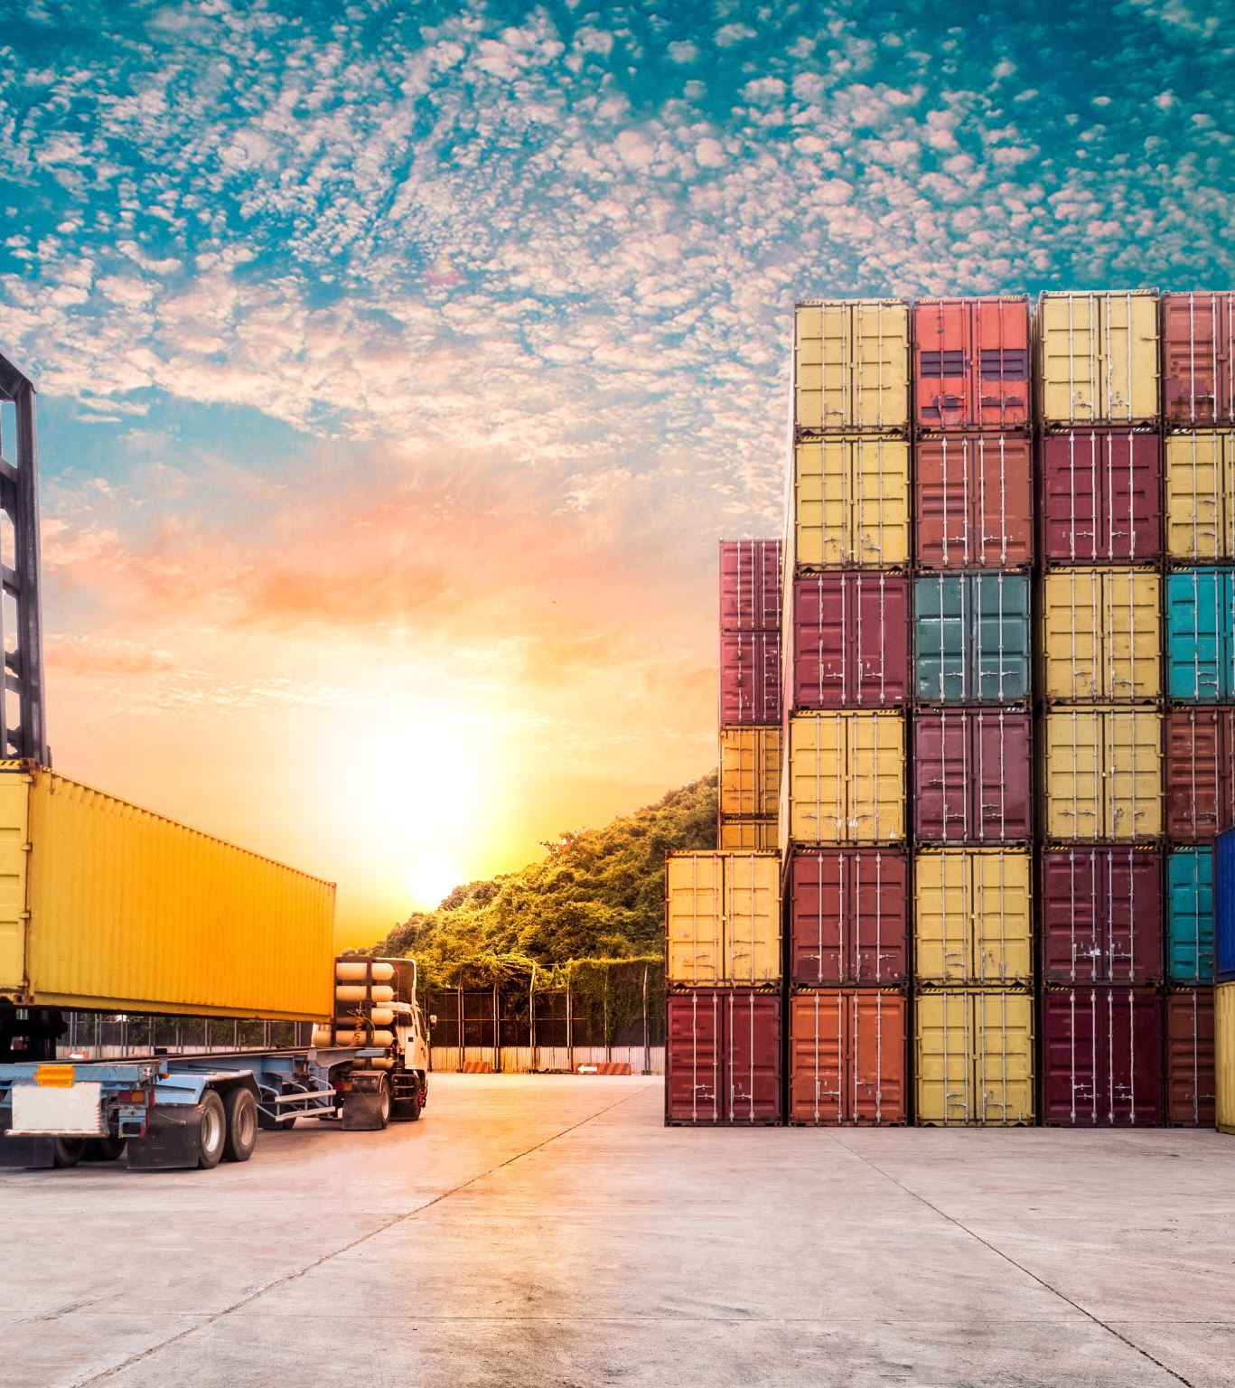
Logistics
The part of supply chain management that plans, implements and controls the efficient flow and storage of goods, services and related information from point of origin to point of consumption.

Slide 13
Key activities
Transportation planning (choosing carriers, routes)
Warehousing (inbound receiving, storage, order picking, outbound shipping)
Inventory control (tracking, safety‐stock planning)
Packaging, handling & material movement

Slide 14
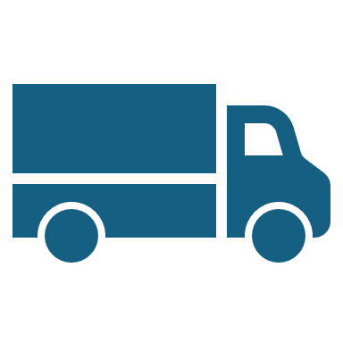
Supply Chain Management (SCM)

Slide 15
Supply Chain Management
The strategic coordination of all supply chain activities and flows—material, information and financial—across multiple organizations, from raw-material suppliers through manufacturers and distributors to end customers.

Slide 16
Network design & facility location
Demand forecasting & planning
Supplier relationship & procurement management
Product design collaboration (e.g., for “design for manufacturability”)
Reverse logistics (returns, recycling)

Slide 17
Supply Chain Management vs. Logistics
SCM includes the high-level processes involved in sourcing and buying raw materials and eventually creating finished goods. SCM uses logistics to deliver goods to the consumer, but it ultimately strives to boost the bottom line and increase a business’s competitive edge.
In other words, SCM sets the strategy and directs daily logistical activities that happen in factories, warehouses, local shipping centers and other facilities. Logistics is an aspect of the supply chain that stores or delivers finished goods or services to the customer, whether that’s a manufacturer, distributor or consumer. The goal of logistics is to get goods and services to the customer on time and at a competitive price. Learn more in our introductory logistics guide.

Slide 18
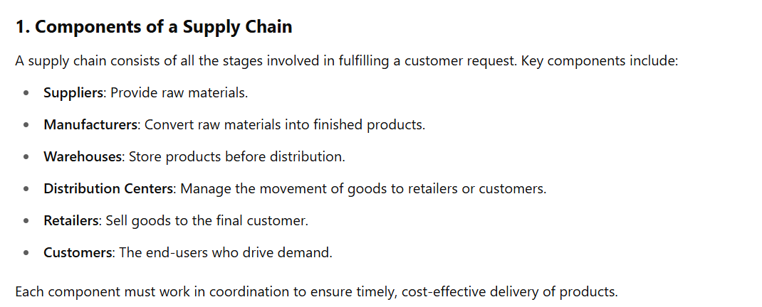

Slide 19
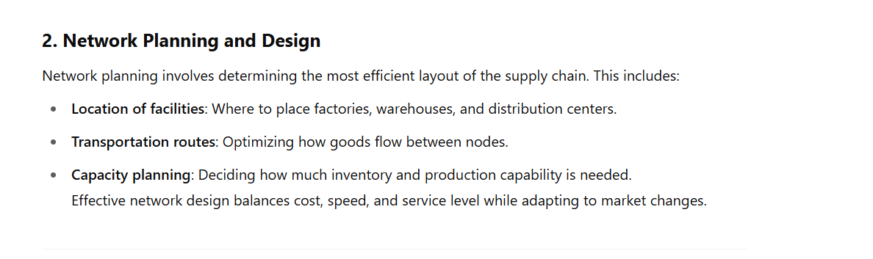

Slide 20
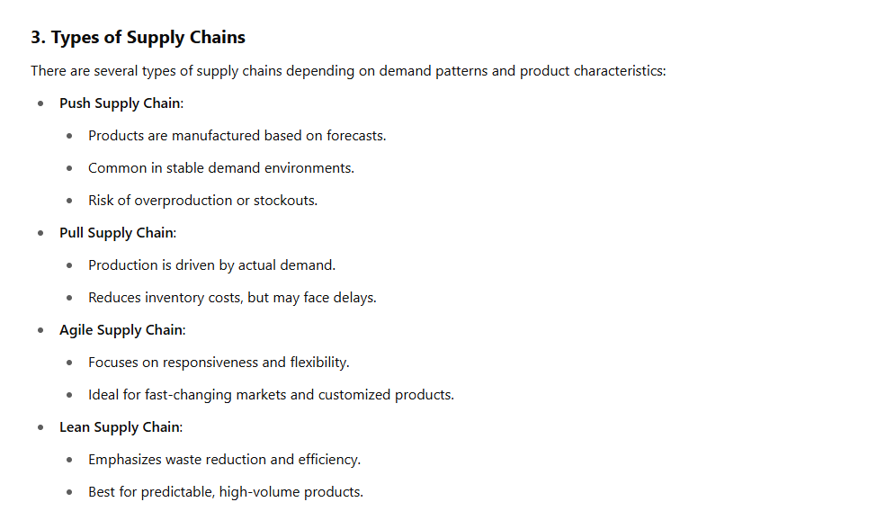

Slide 21
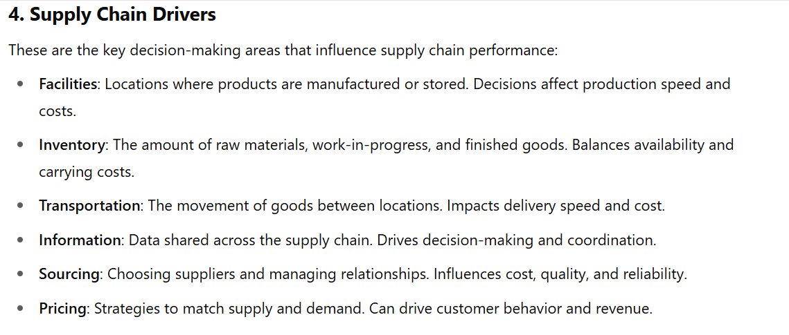

Slide 22
Inventory Management

Slide 23
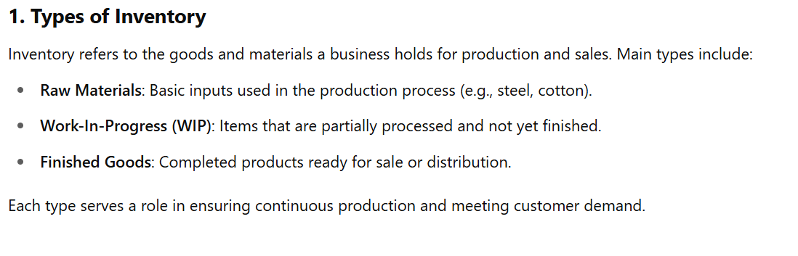

Slide 24
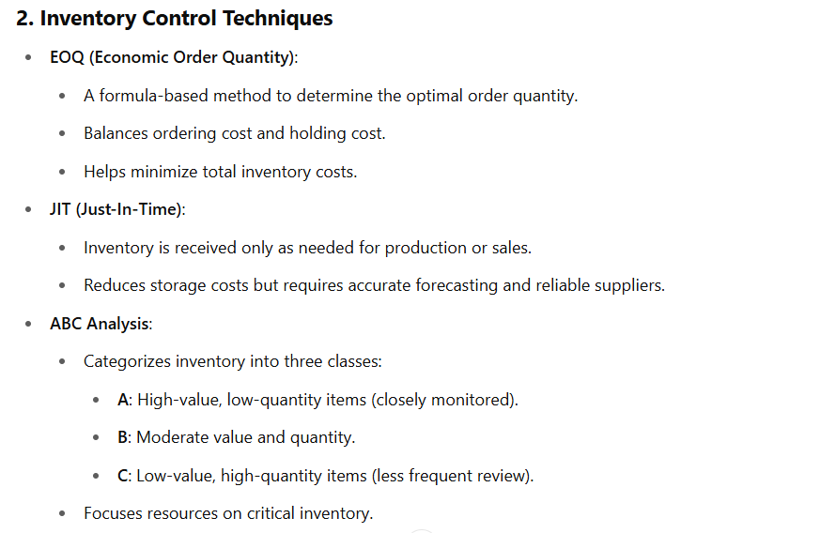

Slide 25
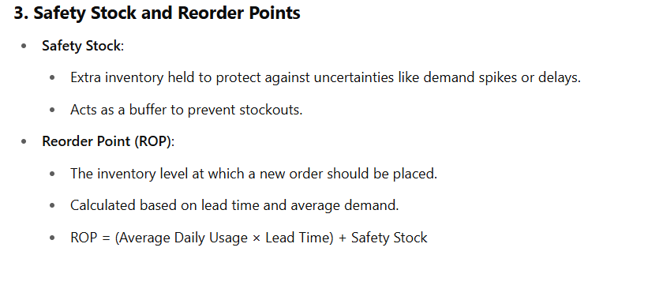

Slide 26
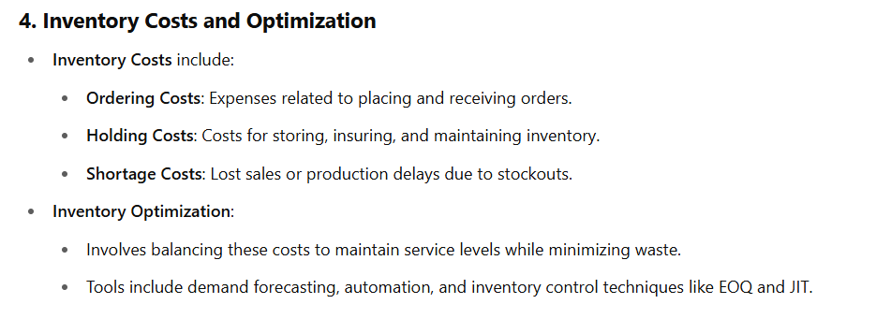

Slide 27
Procurement and Supplier Management

Slide 28
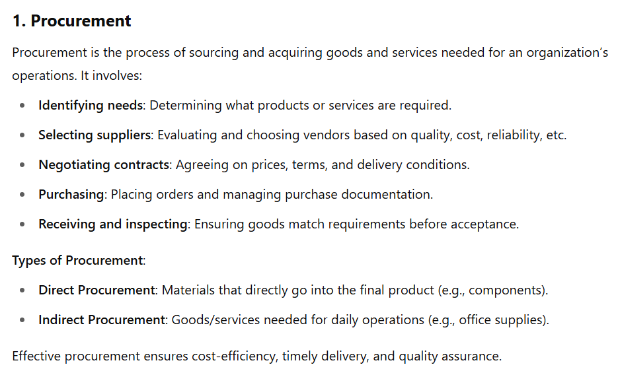

Slide 29
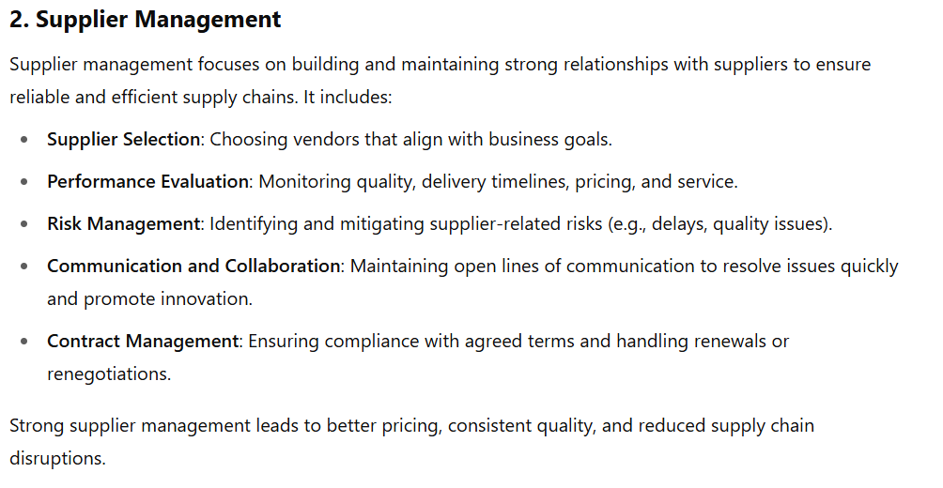

Slide 30
Warehousing and Distribution

Slide 31
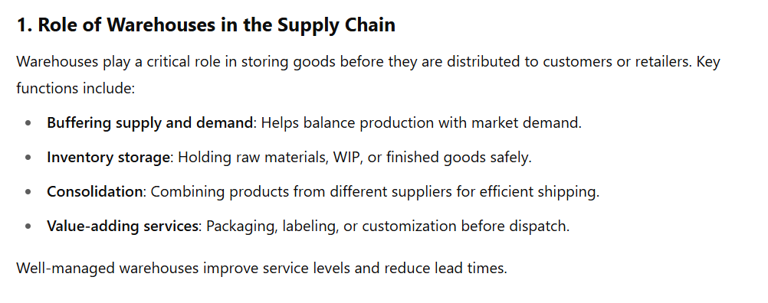

Slide 32
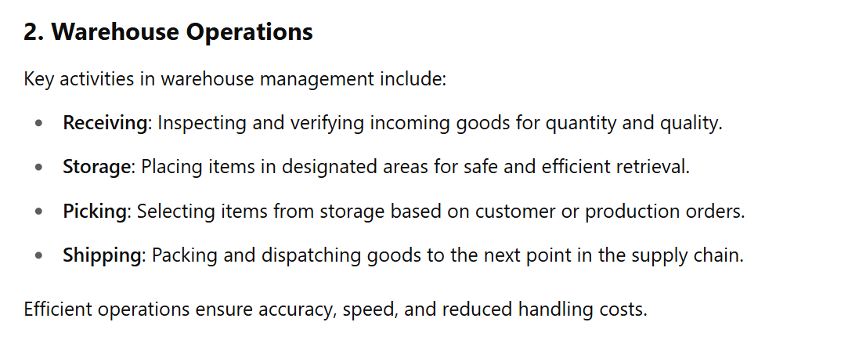

Slide 33
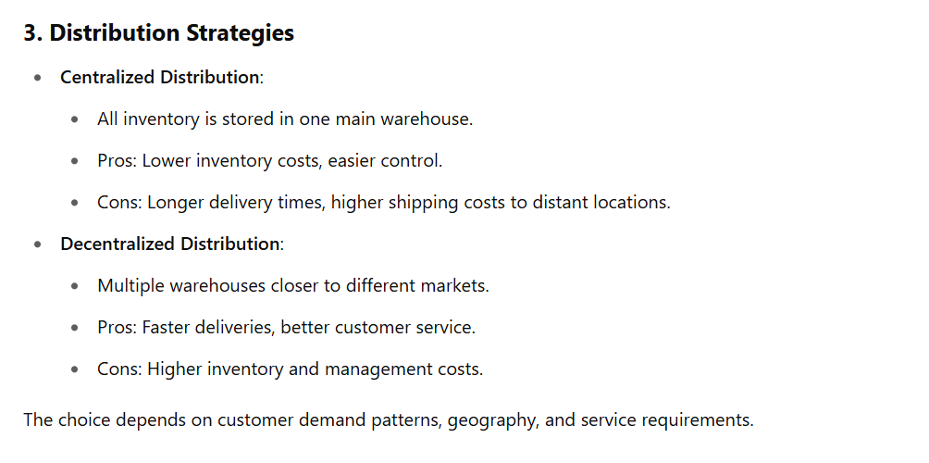

Slide 34
